Slide 1
MELANOMA CLASSIFICATION
Salma Asaad

Slide 2

INTRODUCTION
- Melanoma is one of the most aggressive types of skin cancer as it rapidly spreads to various areas of the body.
- With the increase and fatal nature of melanoma it is of great importance to establish computer-assisted diagnostic support systems to aid physicians in diagnosing skin cancer.

Slide 3
Stages of project
02
Modelling
01
03
Preprocessing
Results

Slide 4
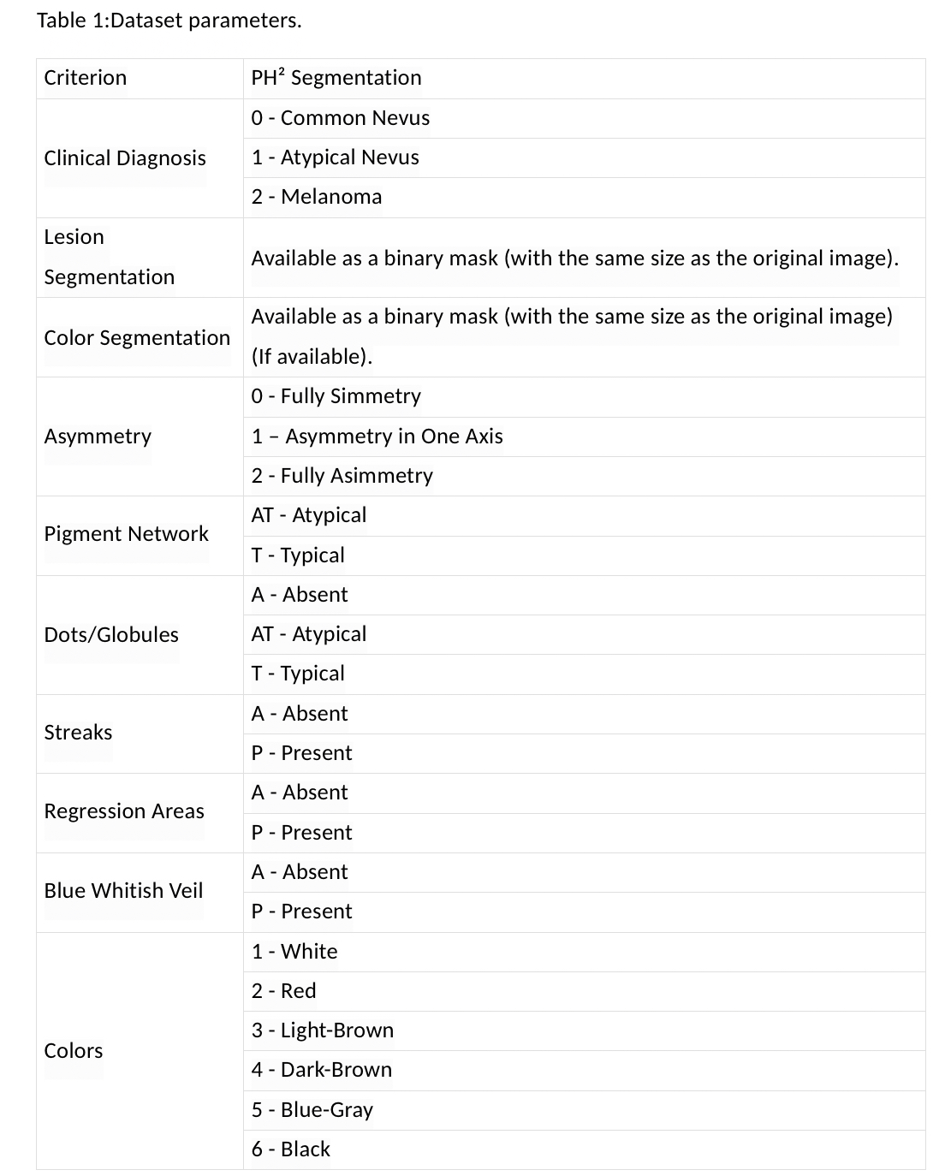
DATASET
The data set contains dermoscopic images of melanocytic lesions, including 80 common nevi, 80 atypical nevi, and 40 melanomas. The PH² database includes medical annotation of all the images namely medical segmentation of the lesion, clinical and histological diagnosis, and the assessment of several dermoscopic criteria (colors; pigment network; dots/globules; streaks; regression areas; blue-whitish veil) ^{[2]}.

Slide 5
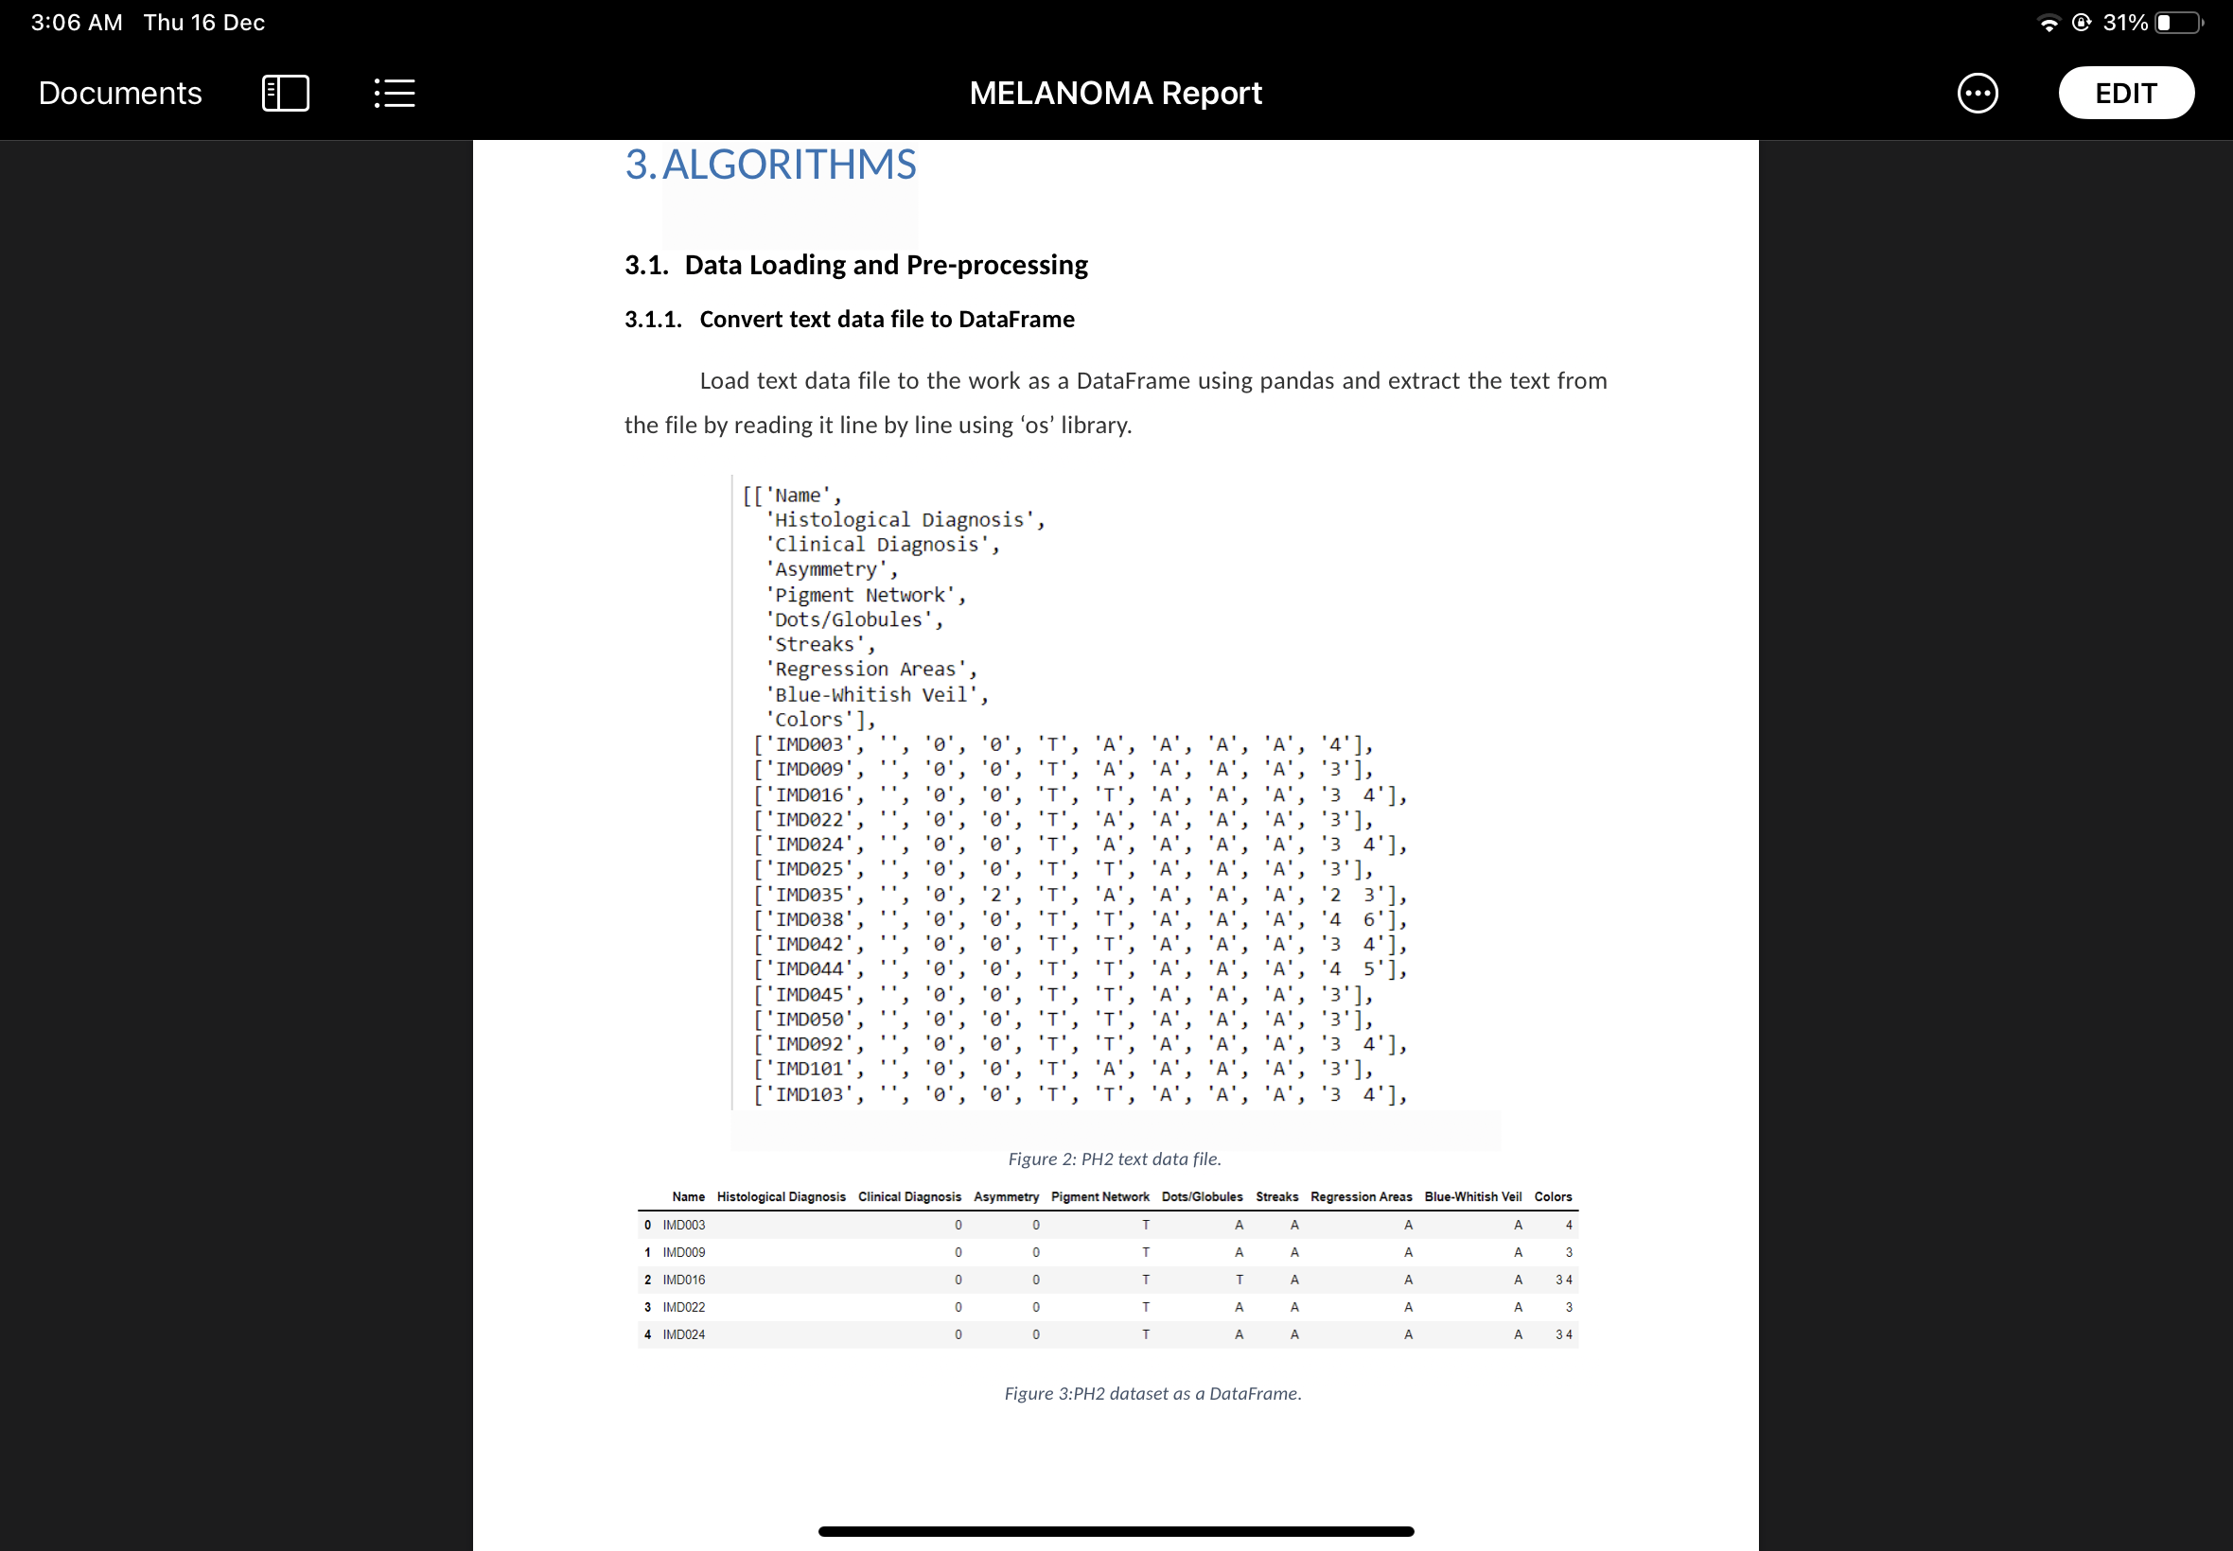
Data loading and preprocessing
1- Converting text data file to Dataframe
Load text data file to the work as a DataFrame using pandas and extract the text from the file by reading it line by line using ‘os’ library.
2- drop all (typical negus) records
Remove all rows that belong to the "1" Atypical Nevus and keep only "0" (common Nevus) & "2" (Melanoma)
3- load image from directory
Listing all the image files paths and names.

Slide 6
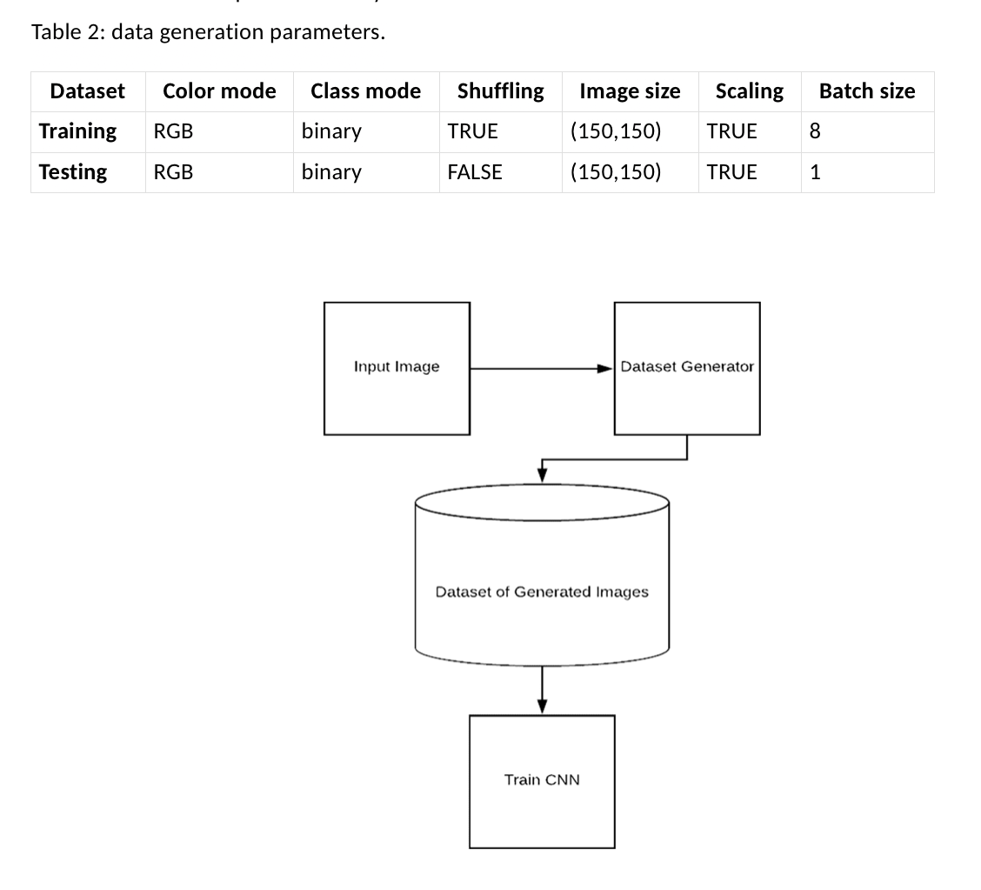
Dataset Generation & Image Processing
Load the original input images from the directory.
Image Processing - Each image needs to be preprocessed before going to the classifier by resizing all the images into a high-dimensional 150 × 150 × 3 matrices based on its RGB values on each pixel, using CV2. Then store the new images in the new directory
Convert data to ImageDataGenerator from the new directory.
Rescale pixels values by 255.

Slide 7
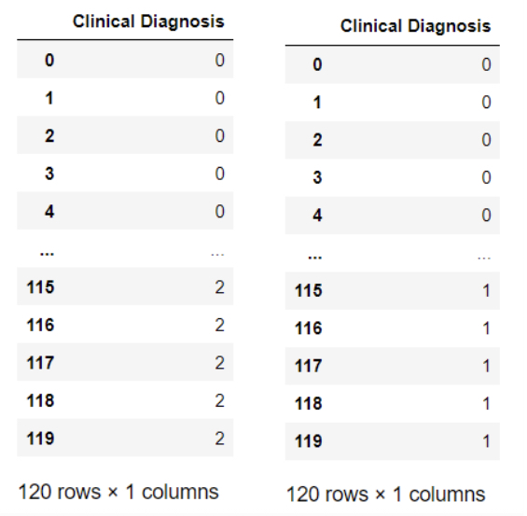
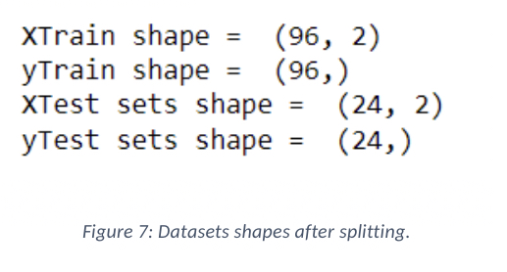
4- Create dataframe for the target column
In the target column (Clinical Diagnosis) I replace the ‘2’ by ‘1’ so that the target column become 1 for (Melanoma) and 0 for (common Nevus).
5- splitting dataset to train and test sets
In the splitting stage, the datasets will be separated by 80%:20% for training and testing sets respectively. The small one is used for testing and evaluating the model while the largest sets are used in training the model.

Slide 8
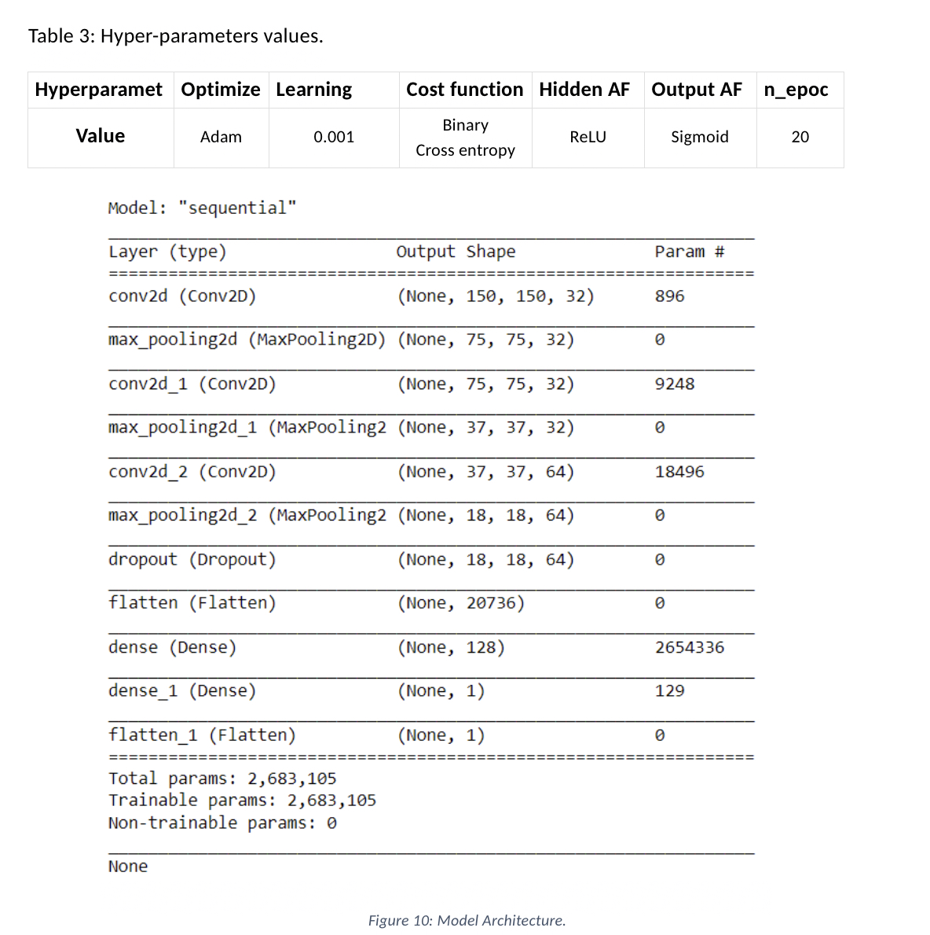
Model Architecture
Among deep neural networks (DNN), the convolutional neural network (CNN) has demonstrated excellent results in computer vision tasks, especially in image classification. Convolutional Neural Network (CNN, or ConvNet) is a special type of multi-layer neural network inspired by the mechanism of the optical and neural systems of humans.

Slide 9
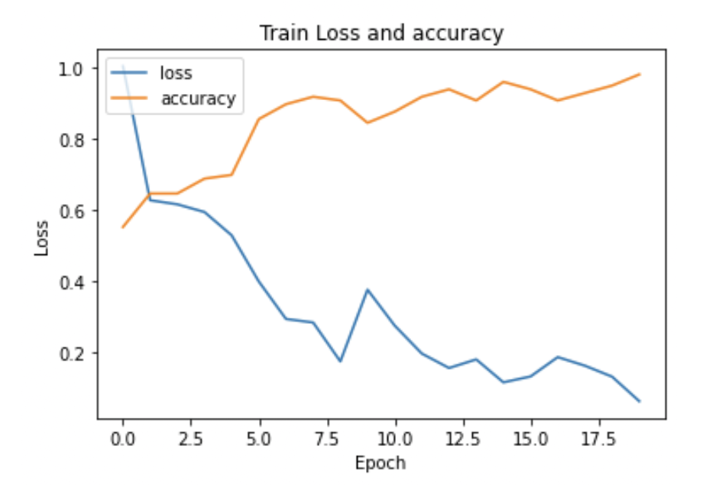
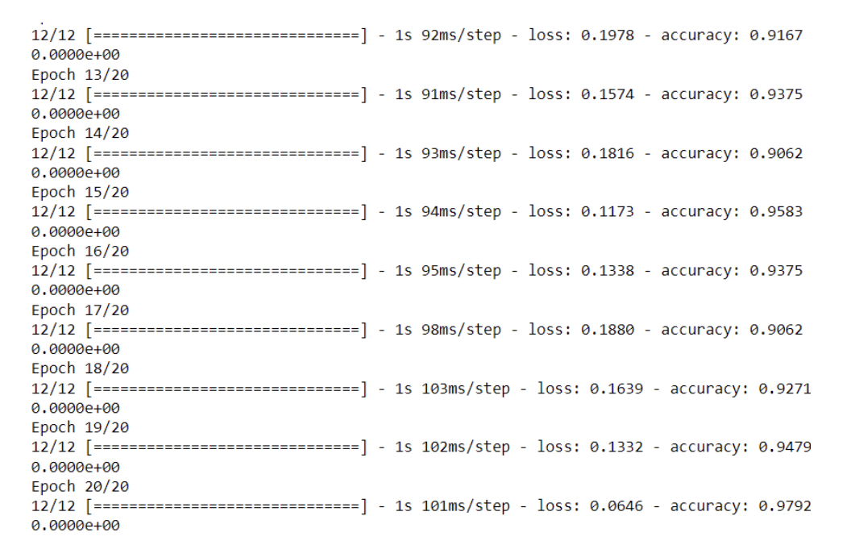
Model Training
Using model.fit_generator to pass data to the model. I passed train and test data to fit_generator. After 20 epochs of the training process, the training accuracy is 97.79%

Slide 10
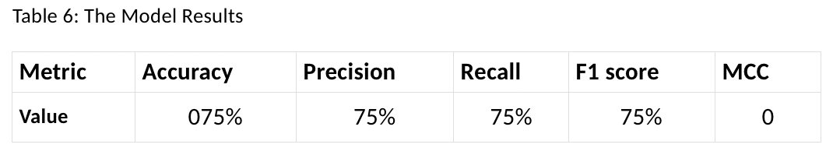
Model Testing & Evaluation
Using the predict_generator function on 24 testing images we got these results.
Y Actual = [0, 0, 0, 0, 0, 0, 0, 0, 0, 1, 0, 0, 0, 0, 1, 1, 1, 0, 1, 1, 0, 0, 0, 0]
Y prediction = [0, 0, 0, 0, 0, 0, 0, 0, 0, 0, 0, 0, 0, 0, 0, 0, 0, 0, 0, 0, 0, 0, 0, 0]

Slide 11
Conclusion
Developing a classification model for classifying the images to Melanoma or not motivated by the performance of Convolutional Neural Networks in computer vision and present a CNN-based model from scratch. The results show that the system performs a training accuracy of 97.5% and testing accuracy 75%.

Slide 12
Tools
Python 3.7.3
TensorFlow 2.4.0 and Keras
Sklearn
NumPy and Pandas
Seaborn and Matplotlib
OpenCV

Slide 13
Thanks for listening ☺

